Slide 1

Concurrency & Semaphores

Slide 2
Multiple Processes
Central to the design of modern Operating Systems is managing multiple processes
  Multiprogramming
  Multiprocessing
  Distributed Processing
Big Issue is Concurrency
  Managing the interaction of all of these processes

Slide 3
Concurrency
Concurrency arises in:
Multiple applications
  Sharing time
Structured applications
  Extension of modular design
Operating system structure
  OS themselves implemented as a set of processes or threads

Slide 4
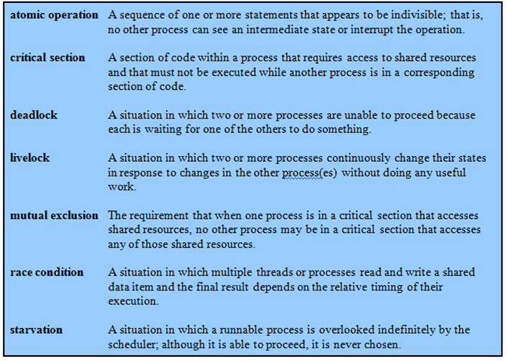
Key Terms

Slide 5
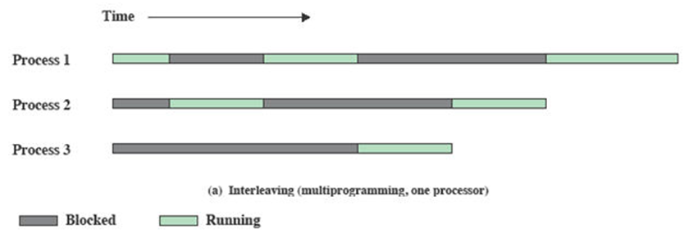
Interleaving and
Overlapping Processes
Earlier we saw that processes may be interleaved on uniprocessors

Slide 6
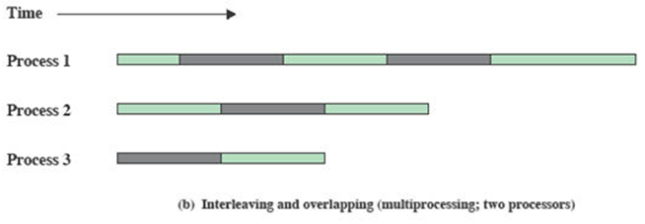
Interleaving and
Overlapping Processes
And not only interleaved but overlapped on multi-processors

Slide 7
Difficulties of
Concurrency
Sharing of global resources- shared read and write by more than one processes
Optimally managing the allocation of resources- by os. Ex process suspended which is granted i/o channel access
Difficult to locate programming errors as results are not deterministic and reproducible.

Slide 8
A Simple Example
void echo()
{
chin = getchar();
chout = chin;
putchar(chout);
}

Slide 9
A Simple Example:
On a Multiprocessor
Process P1 Process P2
. .
chin = getchar(); .
. chin = getchar();
chout = chin; chout = chin;
putchar(chout); .
. putchar(chout);
. .

Slide 10
Enforce Single Access
If we enforce a rule that only one process may enter the function at a time then:
P1 & P2 run on separate processors
P1 enters echo first,
  P2 tries to enter but is blocked – P2 suspends
P1 completes execution
  P2 resumes and executes echo

Slide 11
Race Condition
A race condition occurs when
  Multiple processes or threads read and write data items
  They do so in a way where the final result depends on the order of execution of the processes.
The output depends on who finishes the race last.

Slide 12
Operating System
Concerns
What design and management issues are raised by the existence of concurrency?
The OS must
  Keep track of various processes
  Allocate and de-allocate resources
  Protect the data and resources against interference by other processes.
  Ensure that the processes and outputs are independent of the processing speed

Slide 13
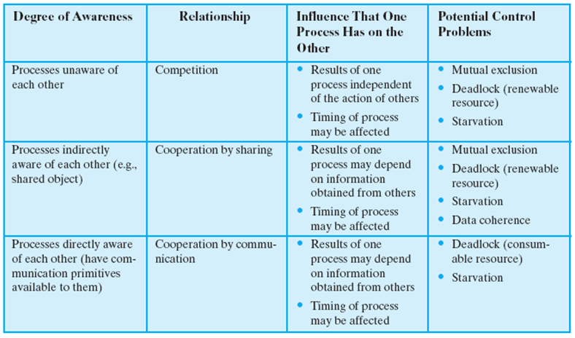
Process Interaction

Slide 14
Competition among
Processes for Resources
Need for mutual exclusion.
  Suppose two or more processes require access to a single nonsharable resource, such as a printer.
  During the course of execution, each process will be sending commands to the I/O device, receiving status information, sending data, and/or receiving data.
    We will refer to such a resource as a critical resource, and the portion of the program that uses it a critical section of the program.
  It is important that only one program at a time be allowed in its critical section.
  We cannot simply rely on the OS to understand and enforce this restriction because the detailed requirements may not be obvious.
  In the case of the printer, for example, we want any individual process to have control of the printer while it prints an entire file.
    Otherwise, lines from competing processes will be interleaved.

Slide 15
The enforcement of mutual exclusion creates two additional control problems:
deadlock.
  Two processes is waiting for the same resources (or each waiting for a resource that the other has exclusive use to)
  Neither will release the resource that it already owns until it has acquired the other resource and performed the function requiring both resources.
  The two processes are deadlocked.
starvation.
  The OS may grant access to resources to a number of processes while neglecting another

Slide 16
Requirements for
Mutual Exclusion
Only one process at a time is allowed in the critical section for a resource
A process that halts in its noncritical section must do so without interfering with other processes
No deadlock or starvation

Slide 17
Requirements for
Mutual Exclusion
A process must not be delayed access to a critical section when there is no other process using it
No assumptions are made about relative process speeds or number of processes
A process remains inside its critical section for a finite time only

Slide 18
In Uniprocessors
Uniprocessors only allow interleaving but no overlapping
Interrupt Disabling – sufficient for mutual excluion
  A process runs until it invokes an operating system service or until it is interrupted
  Disabling interrupts guarantees mutual exclusion
  Will not work in multiprocessor architecture

Slide 19
Pseudo-Code
while (true) {
  /* disable interrupts */;
  /* critical section */;
  /* enable interrupts */;
  /* remainder */;
}

